Slide 1
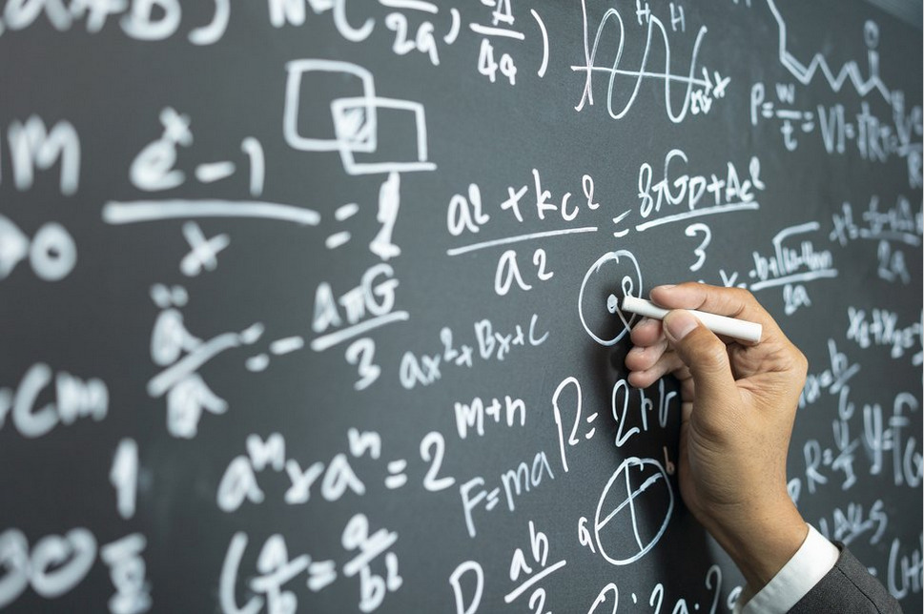
Week # 3
Operations Research
(Software Engineering)

Slide 2
Graphical Method of linear programming
A person requires 10, 12 and 12 units of chemical A, B and C respectively for his garden. A liquid product contains 5, 2 and 3 units of A, B and C respectively per jar. The dry product contains 3, 3 and 4 units of A, B and C respectively per carton. If the liquid product sells for Rs. 3 per jar and dry products sells for Rs. 2 per carton. How many of each should be purchase to minimize the cost and meet the requirement.

Slide 3

Graphical Method of linear programming
Chemicals | Liquid product per Jar | Dry product per carton | Requirement
A | 5 | 3 | 10
B | 2 | 3 | 12
C | 3 | 4 | 12
Min Z= $3x_{1}+2x_{2}$
Subject to Constraints:
$$5x_{1}+3x_{2}≥10$$
$$2x_{1}+3x_{2}≥12$$
$$3x_{1}+4x_{2}≥12$$
$$x_{1},x_{2} ≥0$$

Slide 4
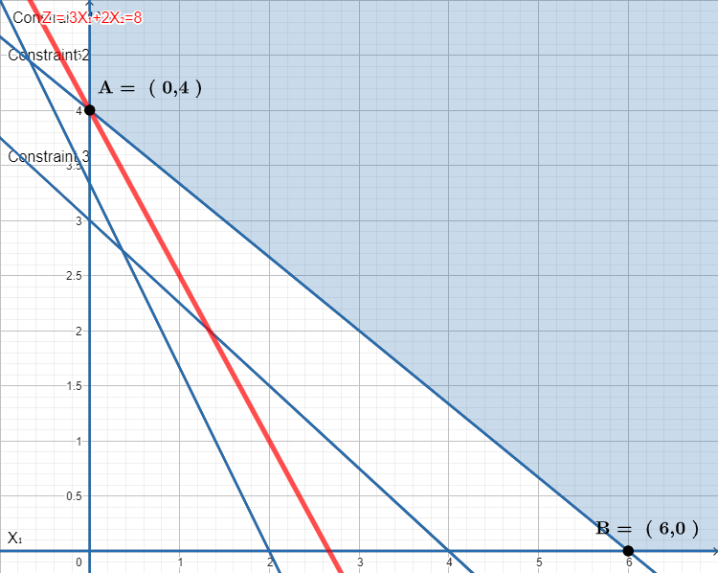

Slide 5
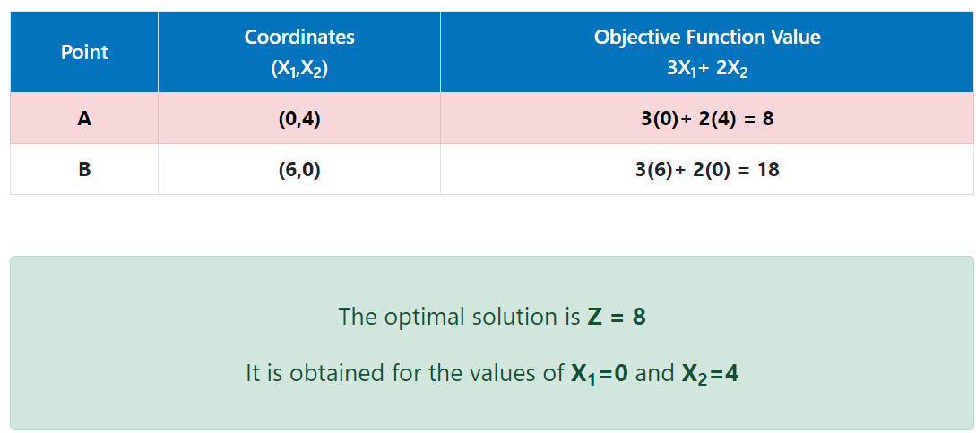

Slide 6
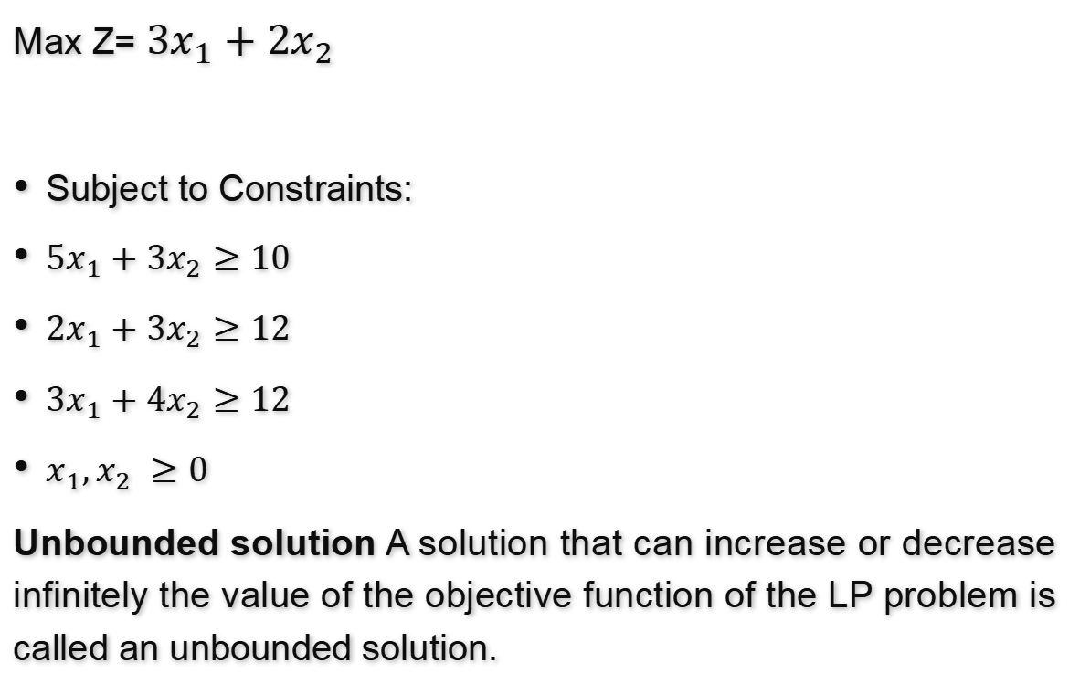
Max Z= $3x_{1}+2x_{2}$
Subject to Constraints:
$5x_{1}+3x_{2}≥10$
$2x_{1}+3x_{2}≥12$
$3x_{1}+4x_{2}≥12$
$x_{1},x_{2} ≥0$
Unbounded solution A solution that can increase or decrease infinitely the value of the objective function of the LP problem is called an unbounded solution.

Slide 7
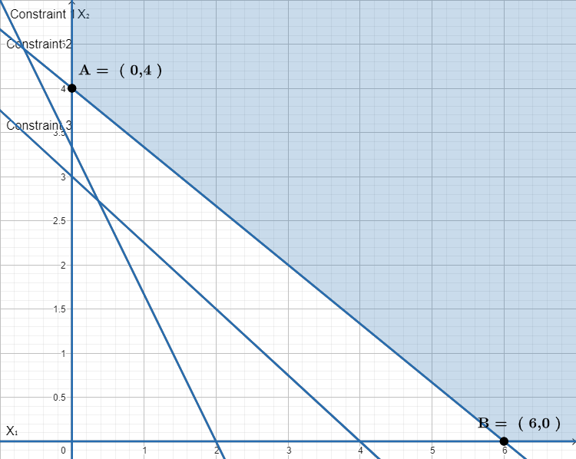
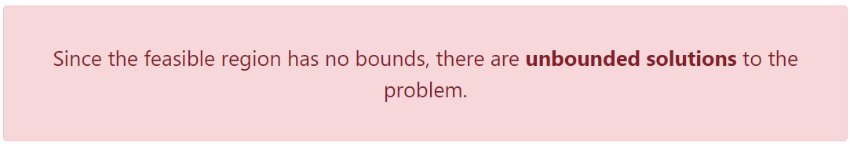

Slide 8
Task
A furniture manufacturer makes two products tables and chairs. Processing of these products is done on two types of machines A and B. A chair requires 2 hours on machine type A and 6 hours on machine type B. A table requires 5 hours on machine type A and no time on Machine type B. There are 16 hours/day available on machine type A and 30 hours/day on machine type B. Profits gained by the manufacturer from a chair and a table are Rs. 2 and Rs. 10 respectively. What should be the daily production of each of the two products? Use graphical method of LPP to find the solution

Slide 9
Infeasible solution
Infeasible means not possible. Infeasible solution happens when the constraints have contradictory nature.
In graphical method, infeasibility happens when we cannot find feasible region.

Slide 10
Infeasible solution
Example 1:
Use the graphical method to solve the following LP problem:
Maximize Z = 6x1 – 4x2
subject to the constraints
2x1 + 4x2 ≤ 4
4x1 + 8x2 ≥ 16
and x1, x2 ≥ 0

Slide 11
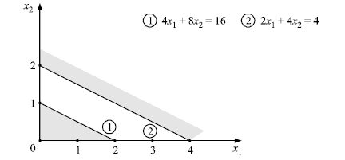
Infeasible solution
The constraints are plotted on graph as usual as shown in Fig. Since there is no unique
feasible solution space, therefore a unique set of values of variables x1 and x2 that satisfy all the constraints cannot be determined. Hence, there is no feasible solution to this LP problem because of the conflicting constraints.

Slide 12
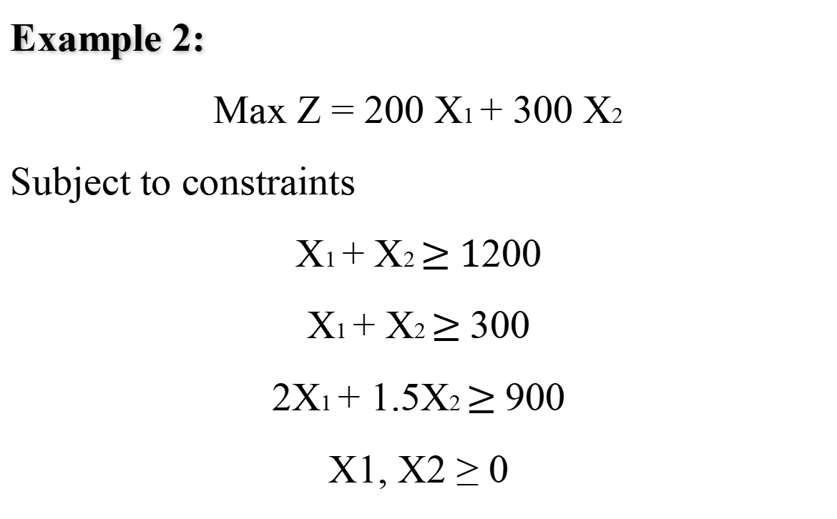
Infeasible solution
Example 2:
Max Z = 200 X1 + 300 X2
Subject to constraints
X1 + X2 $≥$ 1200
X1 + X2 $≥$ 300
2X1 + 1.5X2 $≥$ 900
X1, X2 ≥ 0

Slide 13
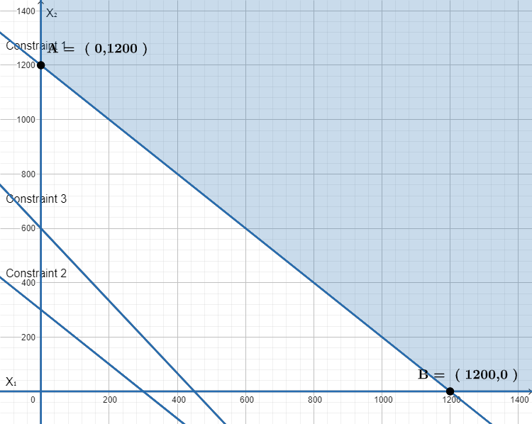
Since the feasible region has no bounds, there are unbounded solutions to the problem.

Slide 14
Redundant Constraint (Redundancy)
A constraint is called redundant when it does not affect the solution. The feasible region does not depend on that constraint.
Even if we remove the constraint from the solution, the optimal answer is not affected.
For instance, if two constraints in an LP problem are: x + 6 y ≥ 36 and 2 x + 12 y ≥ 72 .

Slide 15
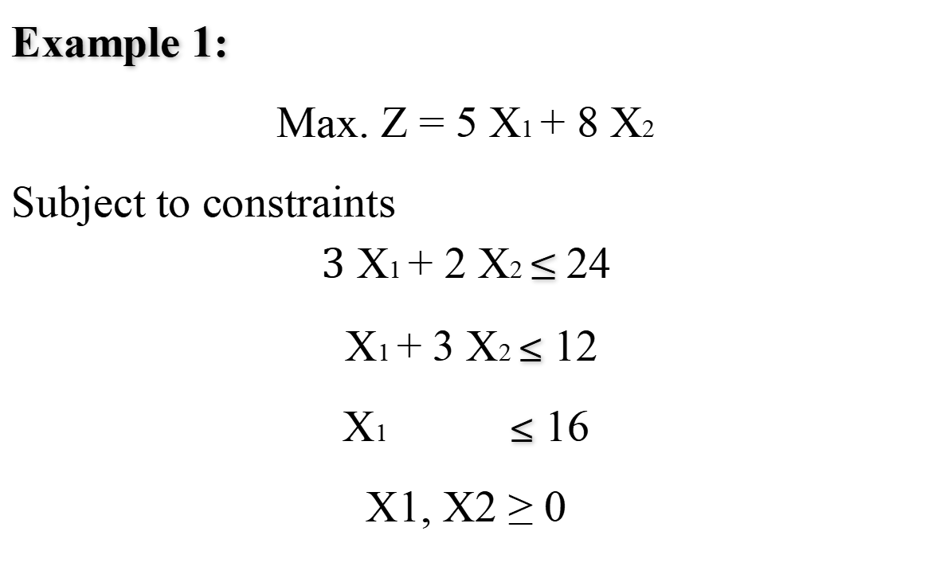
Redundant Constraint (Redundancy)
Example 1:
Max. Z = 5 X1 + 8 X2
Subject to constraints
$$\text{3} \text{X}\text{1} \text{+ }\text{2} \text{X}\text{2} \text{≤} \text{24}$$
X1 + 3 X2 ≤ 12
X1 ≤ 16
X1, X2 ≥ 0

Slide 16
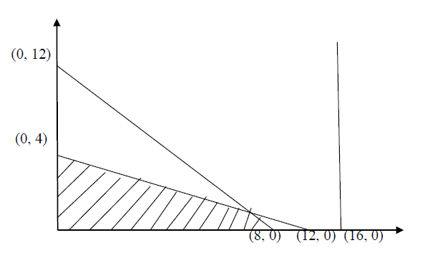
Redundant Constraint (Redundancy)

Slide 17
Redundant Constraint (Redundancy)
The 3rd constraint does not affect the feasible region.
Hence, the constraint X1 ≤ 16 is redundant constraint.

Slide 18
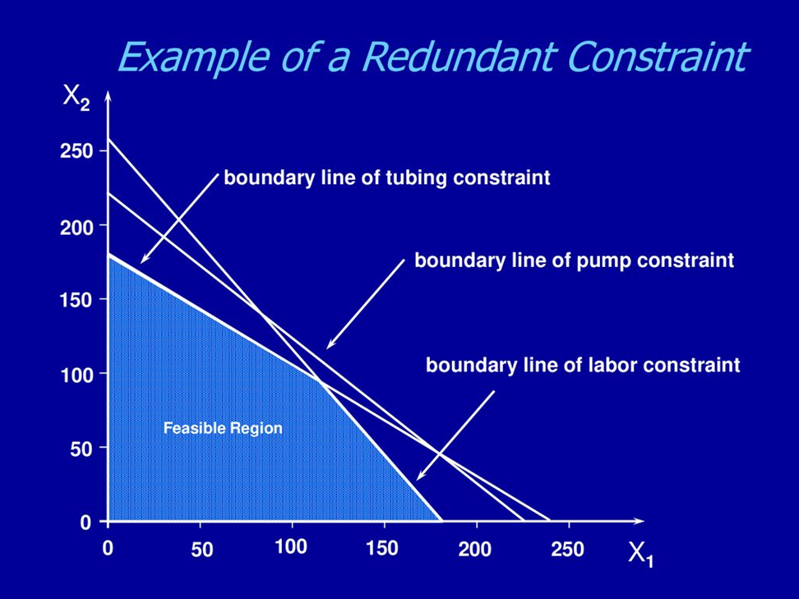

Slide 19
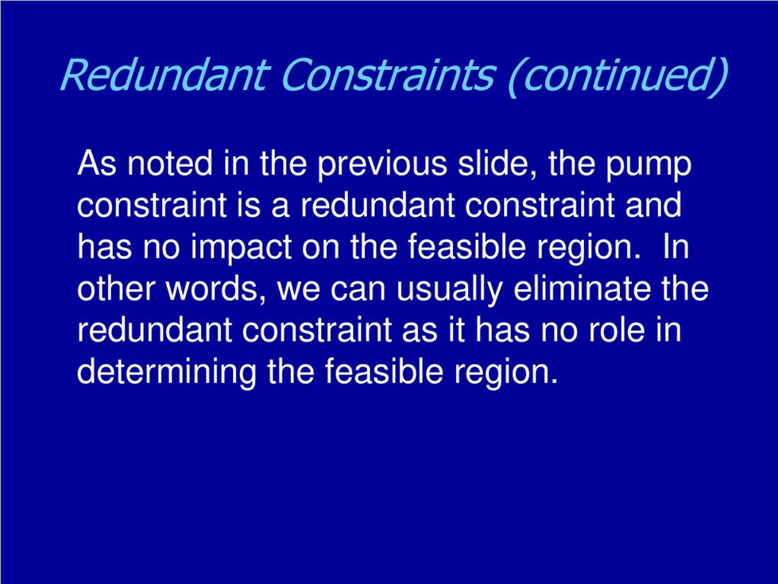

Slide 20
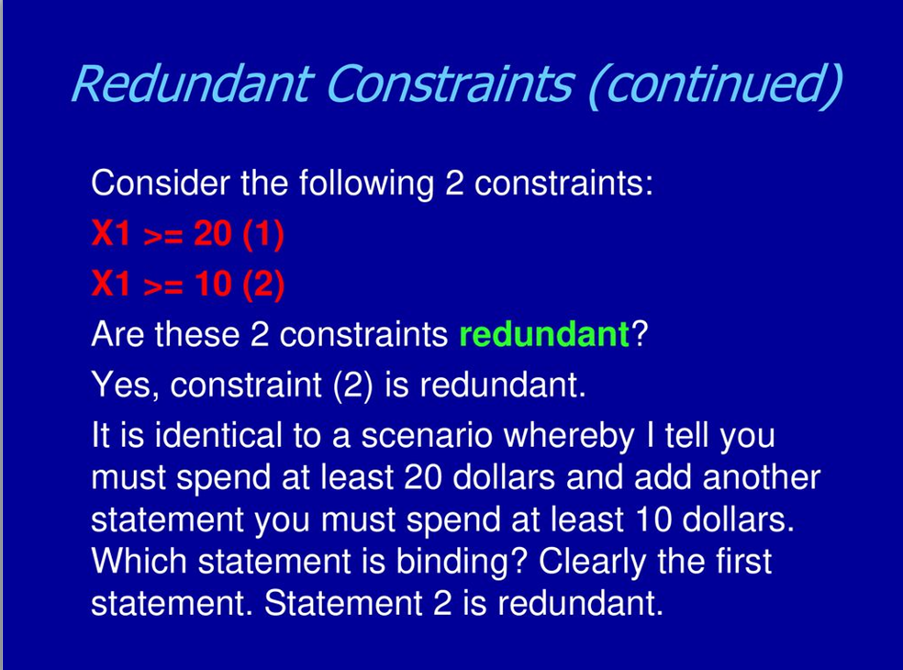

Slide 21
Basic feasible solution
A feasible solution to an LP problem which is also the basic solution is called the basic feasible solution. That is, all basic variables assume non-negative values. Basic feasible solution is of two types:
(a) Degenerate A basic feasible solution is called degenerate if the value of at least one basic variable is zero.
(b) Non-degenerate A basic feasible solution is called non-degenerate if value of all m basic variables is non-zero and positive.

Slide 22
Thank you!

